Slide 1
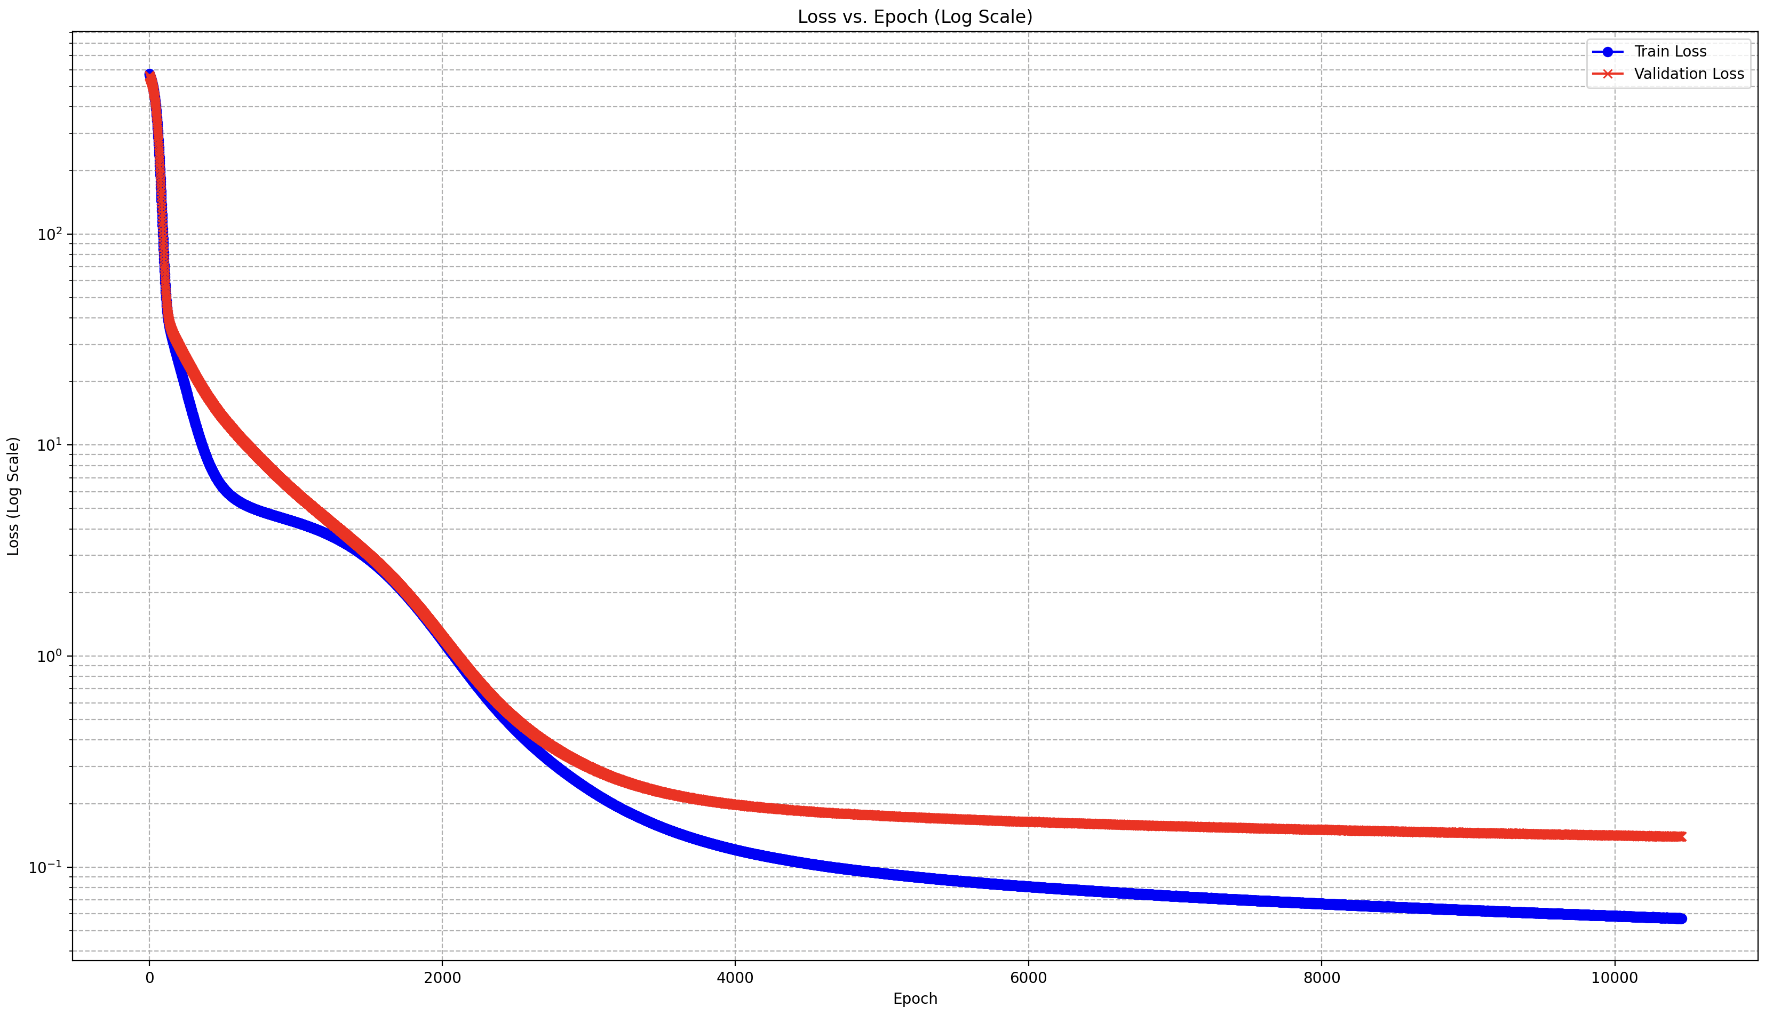
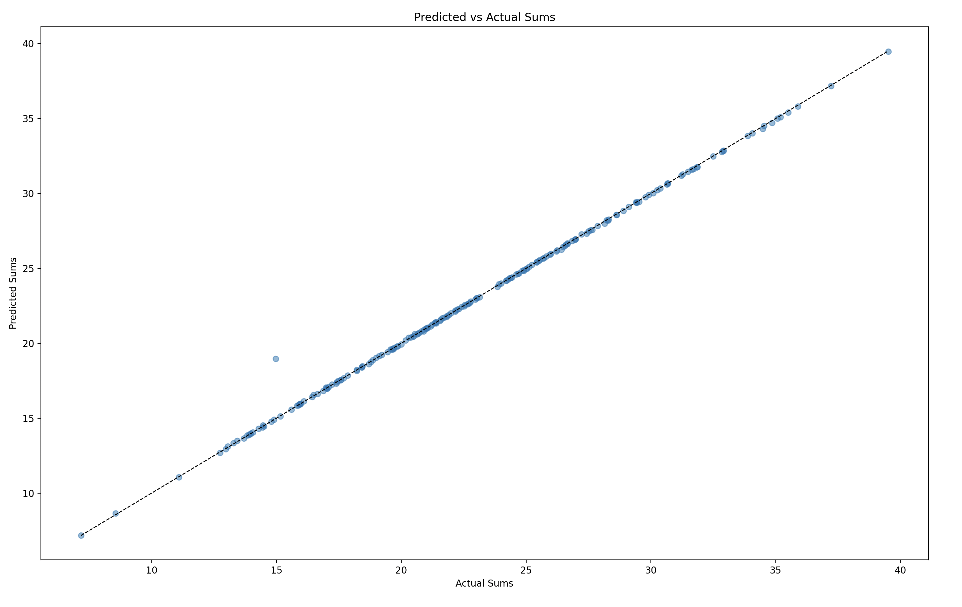
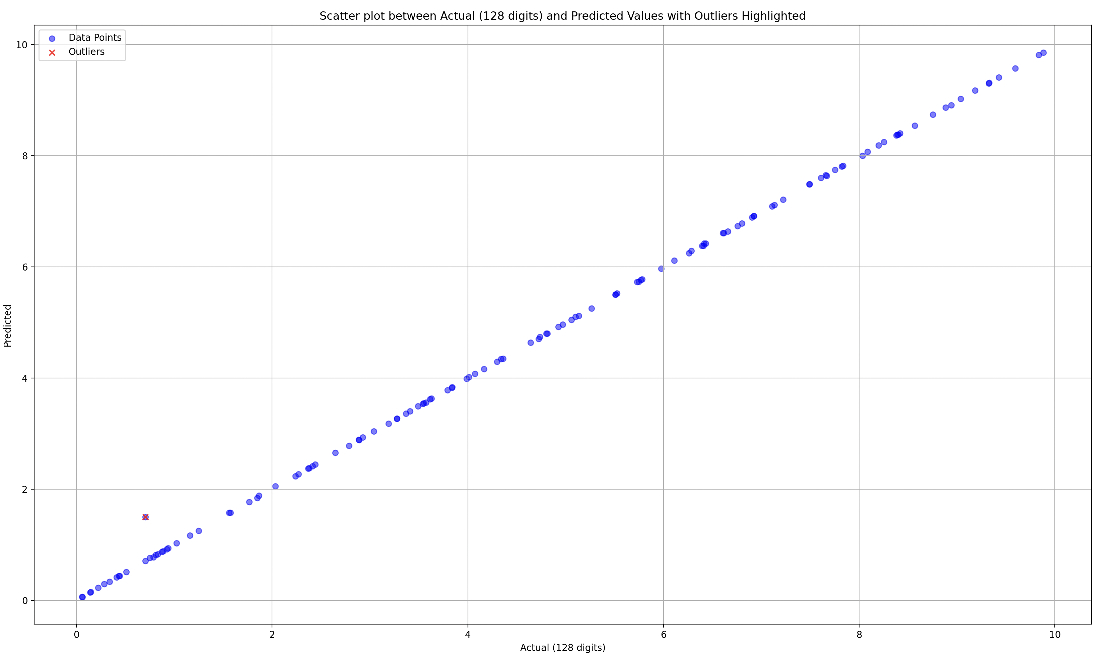
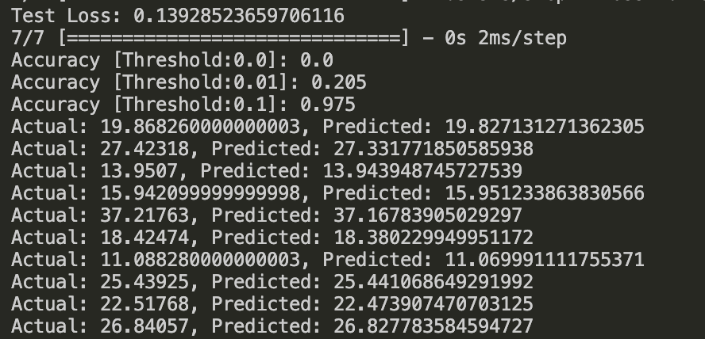
LR: 10(-5), Batch: 128, Decay: 10(-3)
(elu:1024, elu:512)

Slide 2
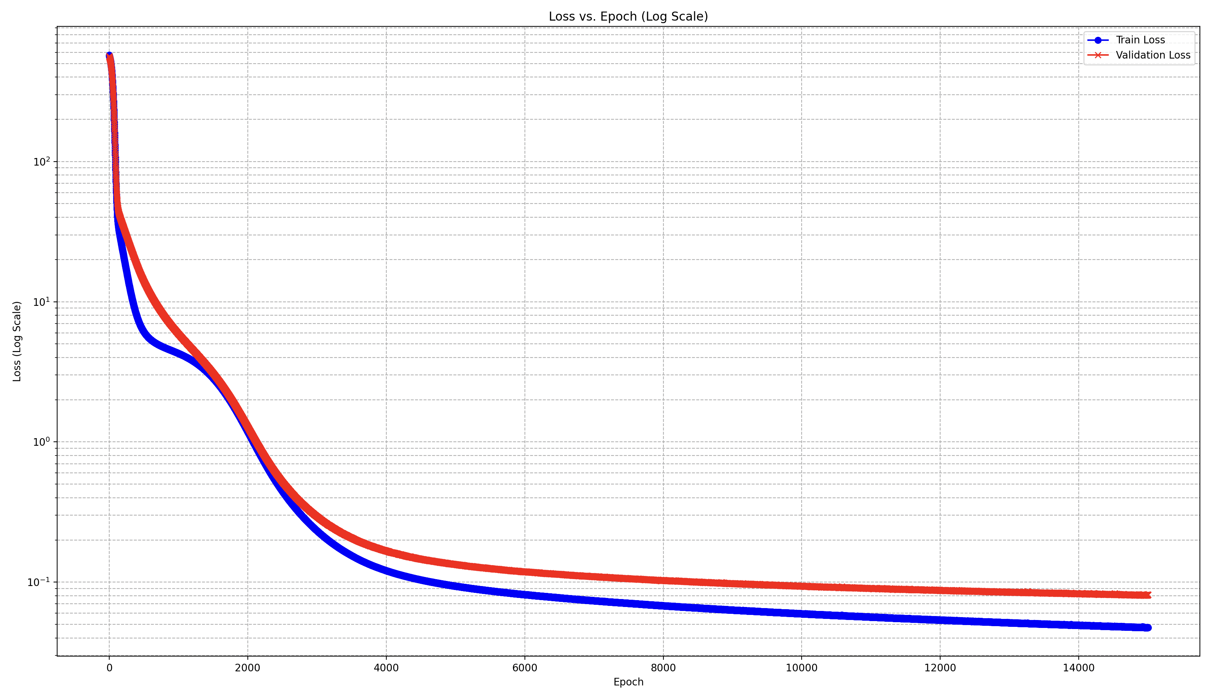
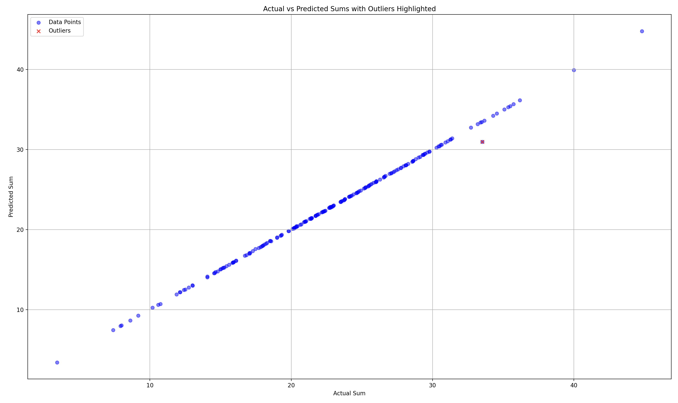
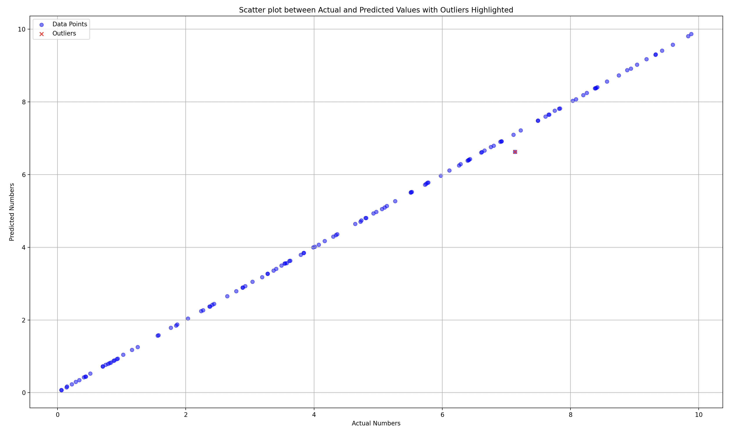
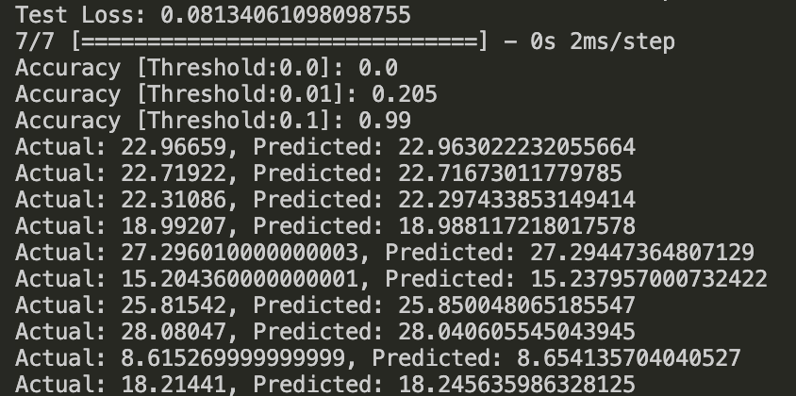
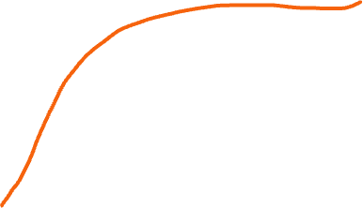
LR: 10(-5), Batch: 128, Decay: 10(-3)
(elu:1024, elu:512)
Outlier -> Actual: [33.51655], Predicted: [30.960732]
Outlier -> Actual: 7.13205, Predicted: 6.623846435546875
Occurs 22 times in training and 9 times in testing

